Slide 1


WECARE: MENTAL HEALTH CHATBOT FOR SUICIDE DETECTION, AND SUPPORT SYSTEM
Dennis Kibet
J17-5580-2020
Supervisor
Ms. Grace

Slide 2
Introduction
Mental health refers to a person's psychological, emotional, and social well-being. It encompasses how individuals think, feel, act, and cope with stress, relate to others, and make choices.
In Kenya one in every four people experience mental illness, common mental health issues include disorders due to substance abuse, neurotic and personality disorders, stress, loneliness and many more issues.
Depression and anxiety disorders are the leading mental illness diagnosed in Kenya.
In Kenya Psychiatric units are only available in 15 of the 47 counties making patients in the other 32 counties to lack the mental health services from these institutions
Kenya has limited resources for those struggling with mental health issues

Slide 3
Problem Statement
Mental health challenges persist in Kenya, affecting approximately 10% of the population, yet a substantial portion remains without adequate assistance (WHO, 2017).
In Kenya accessing mental health services can be challenging due to barriers like stigma, lack of awareness, and scarce resources further exacerbate the situation hindering individuals from accessing the mental health services in a timely manner.
Dr. Susan Njoroge, a mental health advocate, highlights the impact of financial constraints and stigma on accessing care, leading to a substantial gap in appropriate support.

Slide 4
Overall Objective
The main objective of this study was to design, develop and implement a tool that automatically detects depression and suicidal intents which requires less human intervention for the society.
Specific Objectives
1. To review the literature on suicidal detection models.
2. To design the suicidal intents detection ML model.
3. To develop a system utilizing the ML model.
4. To test and implement suicidal and DialogGPT models to the system.

Slide 5
Literature Review
Machine learning Systems – are systems that are capable of learning and adapting to changes in the environment and thus perform tasks without explicit instructions.
Suicidal and Depression Detection in Kenya
Kenya faces a concerning issue regarding suicide and depression detection. The World Health Organization (WHO) reported in 2016 that suicide is a significant public health concern, with an estimated 4.6 suicides per 100,000 population.
"Early recognition of warning signs and accessible mental health services are crucial in preventing suicides" (Patel, 2019).

Slide 6
Literature Review (cont’d…)
Machine Learning Algorithms
1. Convolutional Neural Network (CNN)
As this project attempts to classify text data, the sequence of words plays a part in contributing to the connotation of a sentence.
Convolutional Neural Network (CNN) provides an efficient way to classify text data as it is able to achieve decent prediction accuracy and consume lesser computational resources.

Slide 7
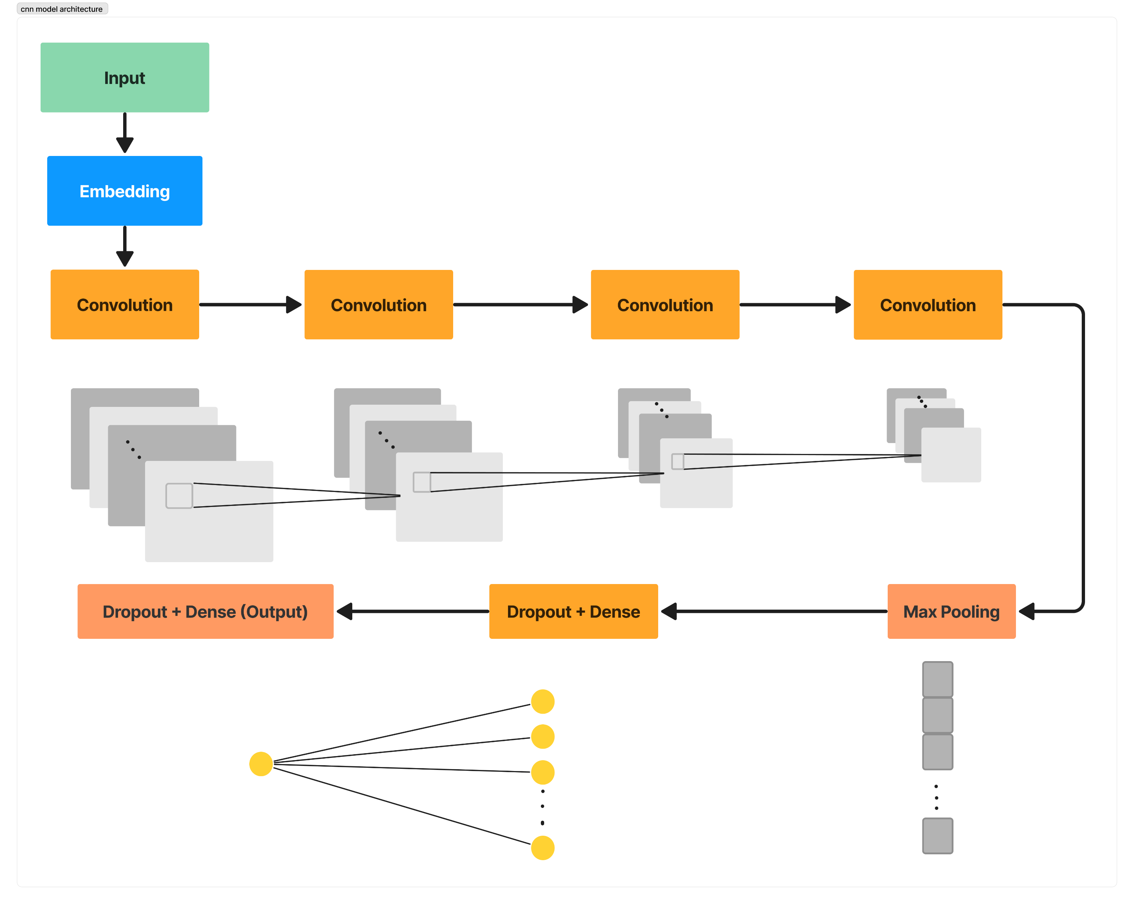
CNN Model Architecture
Convolutional layers extract context, with earlier ones capturing basic info and later ones identifying key features and sentiments. Max-pooling focuses on vital sentence features, regardless of word order. Dropout prevents overfitting, and the final fully connected layer, followed by a sigmoid activation, classifies text as suicidal or non-suicidal.

Slide 8
1. BERT (Bidirectional Encoder Representations from Transformers)
Transformers Algorithms
BERT utilizes the encoder structure of a transformer for language modelling and was developed by Google in 2018.
BERT is pre-trained on 2 tasks, namely Masked Language Model (MLM) and Next Sentence Prediction (NSP). The MLM technique enables bidirectional training in contrast to previous models which looked at a text sequence from a single-direction or combined bidirectional training

Slide 9
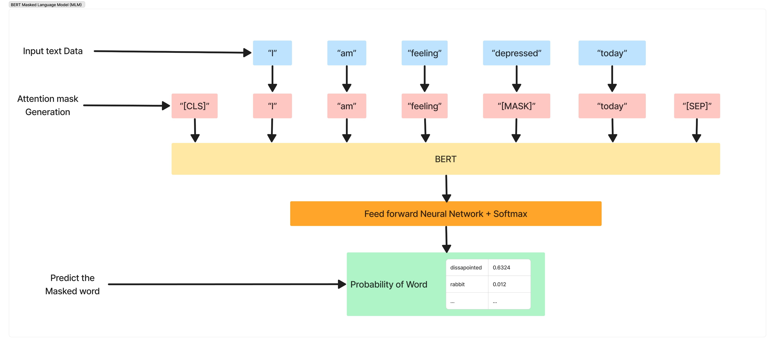
The input sentence “I am feeling depressed today” will be transformed into “I am feeling [MASK] today” after masking. The model is then trained to replace the masked tokens with the correct word, which has allowed the model to learn more accurate representations with the attention mechanism. MLM replaces 15% of the words in the sequences with a “[MASK]” token for training purposes.
MLM Model Architecture

Slide 10
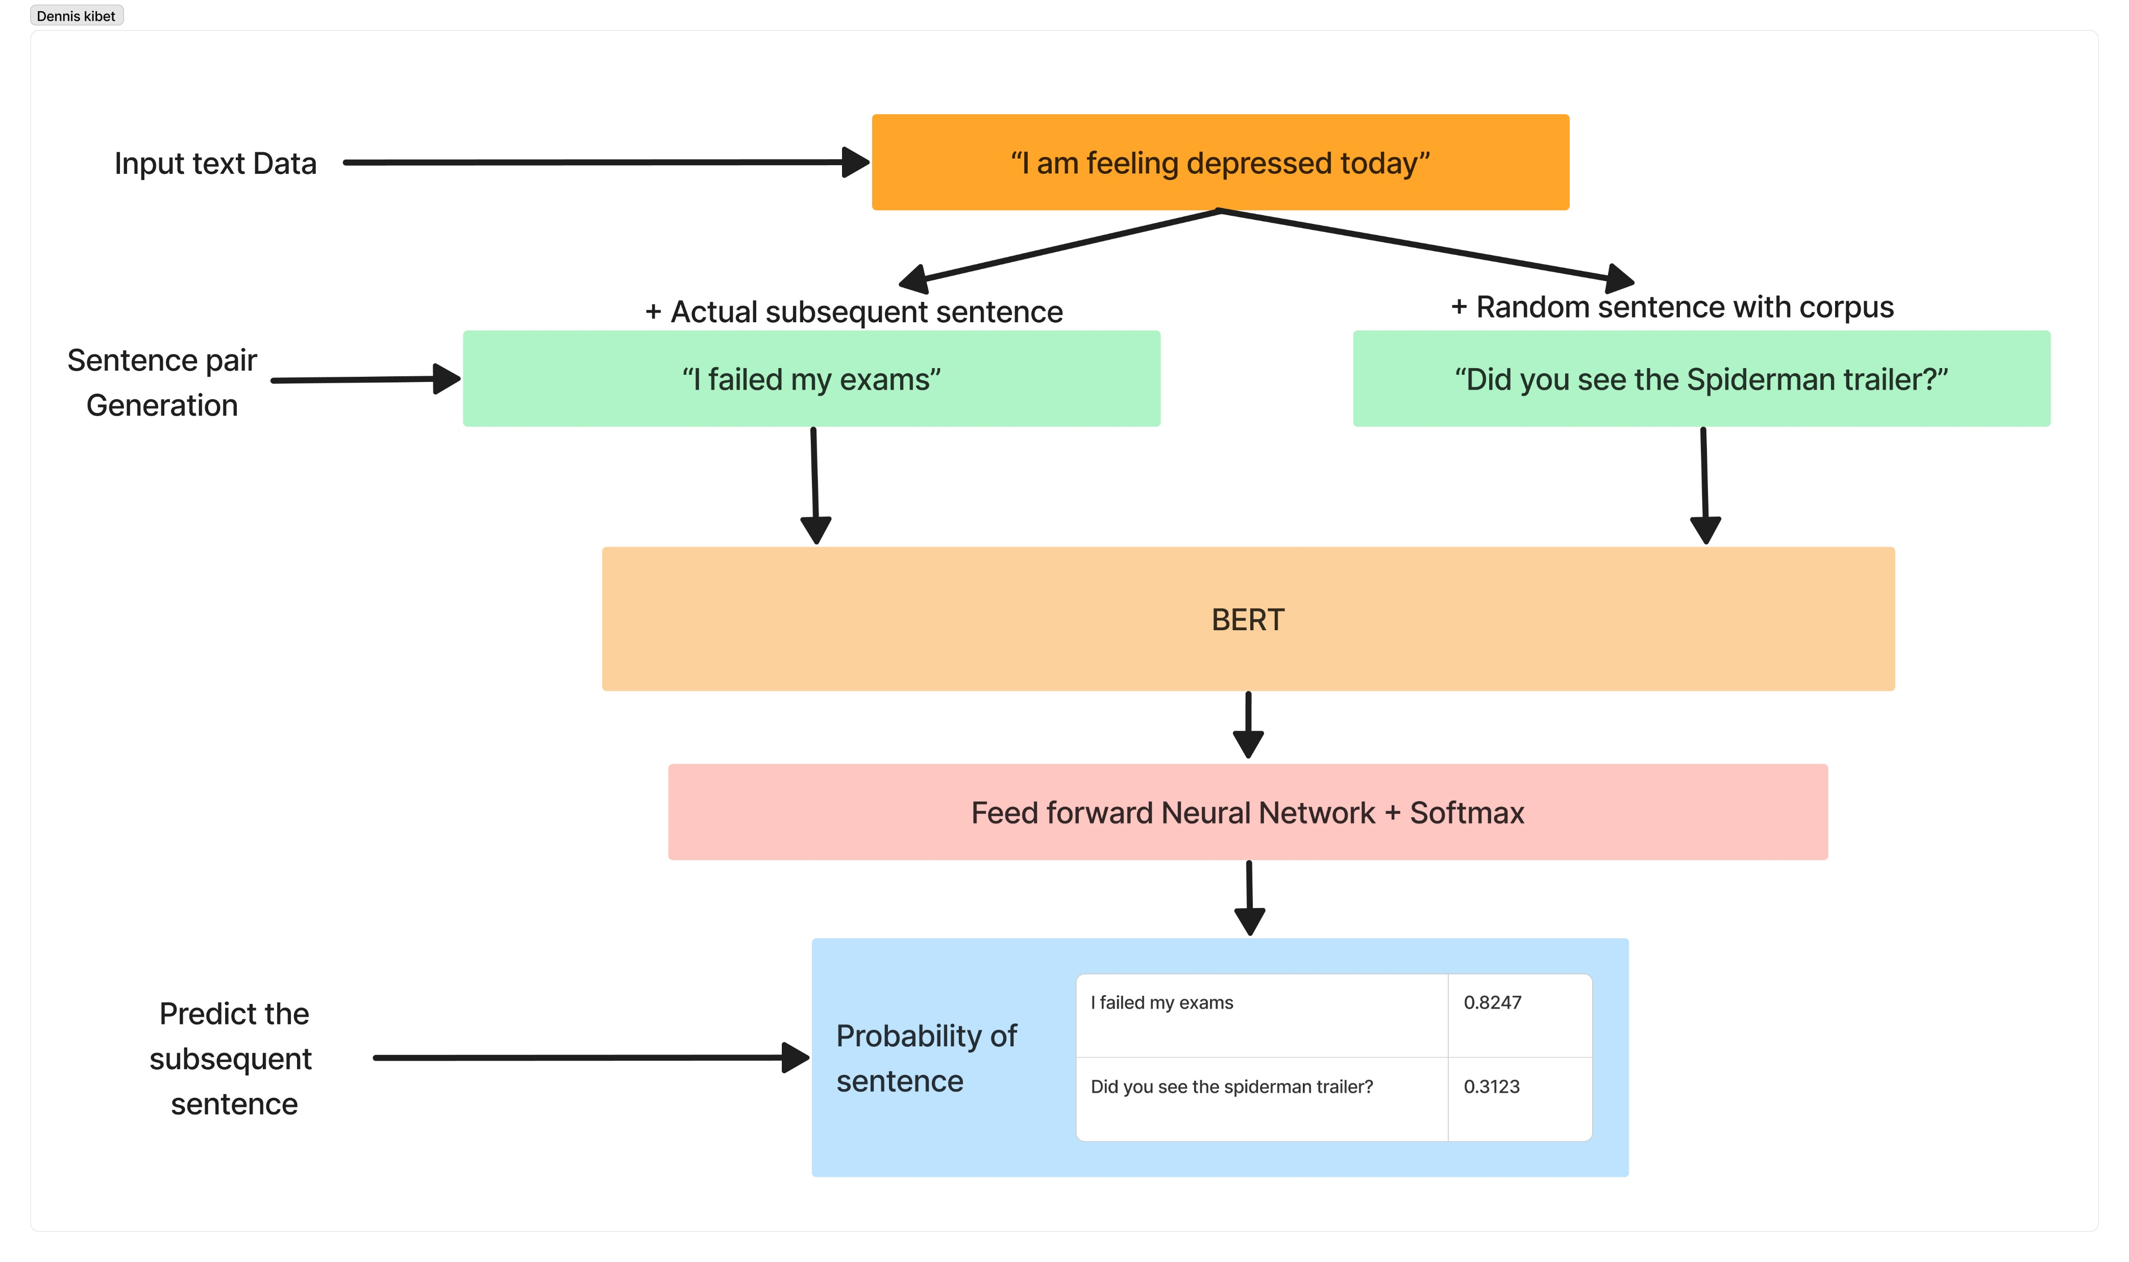
BERT NSP Model Architecture
MLM focuses on token-level features but lacks sentence-level understanding. To incorporate this, BERT uses the Next Sentence Prediction (NSP) task during training. It learns by predicting whether a second sentence follows another in a pair. For instance, given the input "I am feeling depressed today," BERT identifies "I failed my exams" as the actual subsequent sentence and "Did you see the Spiderman trailer?" as a random sentence from the corpus. Each pair of sentences, one real and one fake, is used for training. The model uses special tokens "[CLS]" and "[SEP]" to mark sentence boundaries. BERT was pre-trained on 3.3 billion words from English Wikipedia and Books Corpus, available in base and large versions.

Slide 11
2. ELECTRA (Efficiently Learning an Encoder that Classifies Token Replacements Accurately)
ELECTRA is one of the latest pre-trained transformer models released by Google in 2020.
ELECTRA on the other hand outperforms the other models on a few benchmark datasets with less than a quarter of the required computation power.
ELECTRA adds a new way called Replaced Token Detection (RTD) to address the limitations of the masked language Model (MLM) technique used in BERT, which involves replacing input tokens with masked tokens.

Slide 12
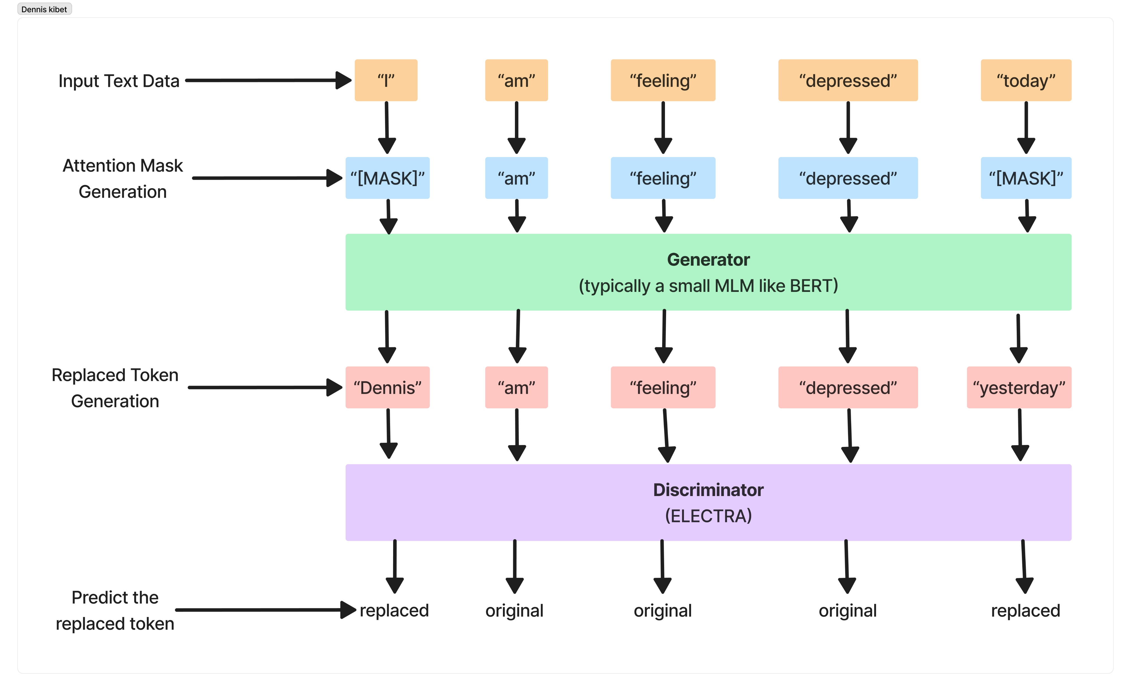
ELECTRA Model Architecture
ELECTRA trains a bidirectional model using Replace Token Detection (RTD) instead of "[MASK]" tokens. For instance, "I am feeling depressed today" can become "Dennis am feeling depressed yesterday," using plausible but incorrect replacements. The discriminator distinguishes between original and replaced tokens. This approach requires less training data for equivalent performance as it uses richer information per example. Tokens for replacement are generated by a smaller model like BERT, with both the generator and discriminator co-trained while sharing the same input embeddings.

Slide 13
Model Selection and Evaluation
After the extensive comparison of the Machine Learning Algorithms, and evaluating the performance of the MLA models based on four evaluation metrics:
Accuracy
Precision
Recall
Final Best Score (F1 score)
I used the final best score for my use case to ensure a better model in handling the downstream tasks in our application. False negatives are not ideal, F1 score provides a more balanced perspective of the model performance compared to the other metrics.

Slide 14
Related Systems
Arif Chatbot project in Kenya – during the Tech4MentalHealth challenge organized by Basic Needs Basic Rights Kenya and Zindi in 2019. Zindi, Mtoto News, Basic Needs Basic Rights Kenya, and Qhala collaborated and made a chatbot API named Arif that uses the Telegram chat-services to access its users. It is vulnerable to false negatives due to the MLA used to make the chatbot.
Vera: A WhatsApp Chatbot – Vera chatbot made by Zuri health is used by the Zuri health facility to access the hospital mental health services, but it is not fully autonomous and required frequent intervention by the hospital’s doctors

Slide 15
Research Gap
There exists a significant research gap in understanding the complexities of Machine Learning’s effectiveness and ethical considerations surrounding their implementation.
Studies generally focus on technical functionalities and user satisfaction, neglecting several critical aspects like Personalization, Clinical Validation, Ethical Considerations, User Engagement and Long-term Adoption, Integration with Existing Mental Health Services and Cultural and Socioeconomic Considerations.
The model used in this study will be addressing these research gaps, and thus contributing to a more comprehensive understanding of the potential of mental health chatbots as a tool for offering support.

Slide 16
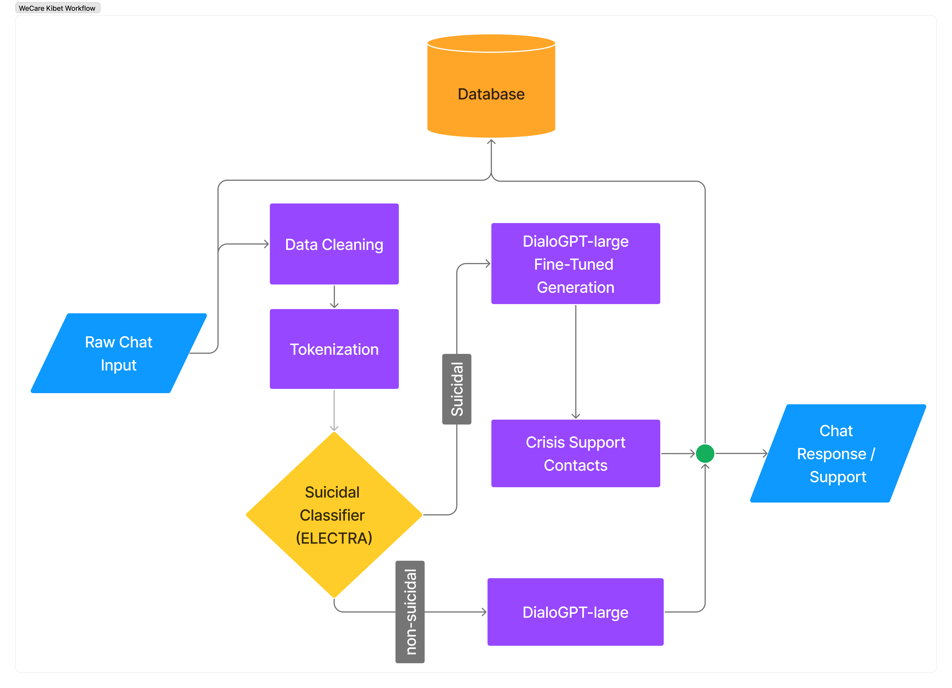
Conceptual Framework

Slide 17
Research Methodology
Research design - The primary research problem was text categorization, primarily yielding qualitative results. The research leaned towards mathematical methods for automatically detecting underlying patterns in text to generate a model.
Sampling Method - The study employed a straightforward random sampling technique to construct a representative sample for annotation within the extensive Kaggle dataset. Utilizing convenience sampling.
Data Collection methods – Observation and Questionnaires

Slide 18
Functional Requirements
User Authentication - Users can create an account and log in to access the application's features securely.
Chat Initiation - Users can start conversations with the chatbot to engage in dialogue.
Sentiment Analysis - The application analyzes the sentiment of user messages to classify them accordingly.
Response Generation - The application generates responses to user chats based on the content of the messages.
Suicide Prevention Support - The application provides supportive and helpline messages when detecting potentially suicidal texts.

Slide 19
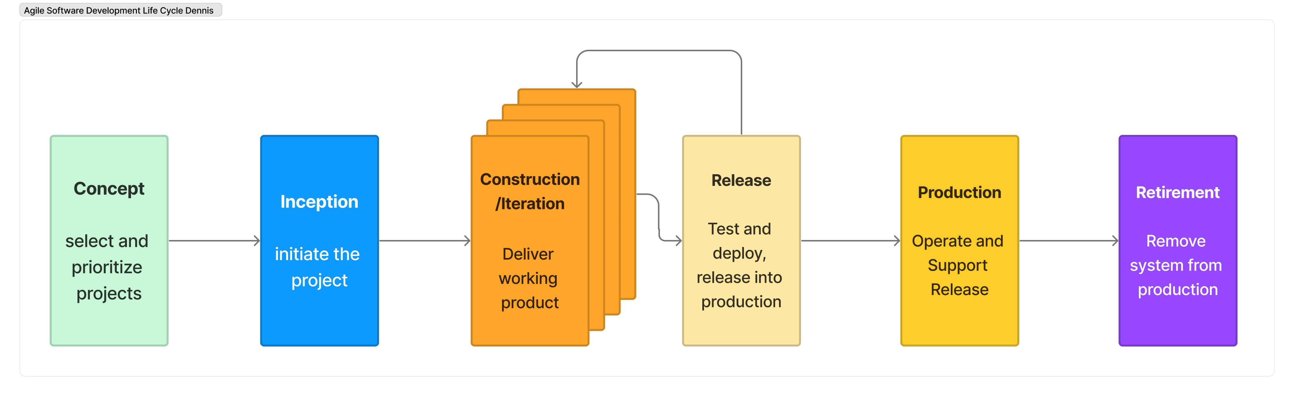
Process Model - Agile methodology
This study project employed the Agile method due to its iterative and flexibility when demands or requirements change. Agile method’s responsiveness to evolving requirements, aligned closely with the dynamic nature of the research objectives.

Slide 20
Agile Methodology (cont’d…)
Concept – Observing and identifying the issue in addressing mental health issues in Kenya.
Inception - I outlined the technical and functional requirements for the mental health chatbot project. Specifically, I detailed how the functionalities outlined in the functional specifications will be implemented.
Construction / Iteration - the core functionality of the chatbot was built, ensuring that it provided meaningful support and guidance to users in distress
Release - Testing and quality control, Prototyping and review, documentation, training and deployment.
Production - Operating the project at scale, maintaining it for users while continuously improving its features.
Retirement – This is the planned phase where the system becomes obsolete and is decommissioned or replaced due to shifting priorities.

Slide 21
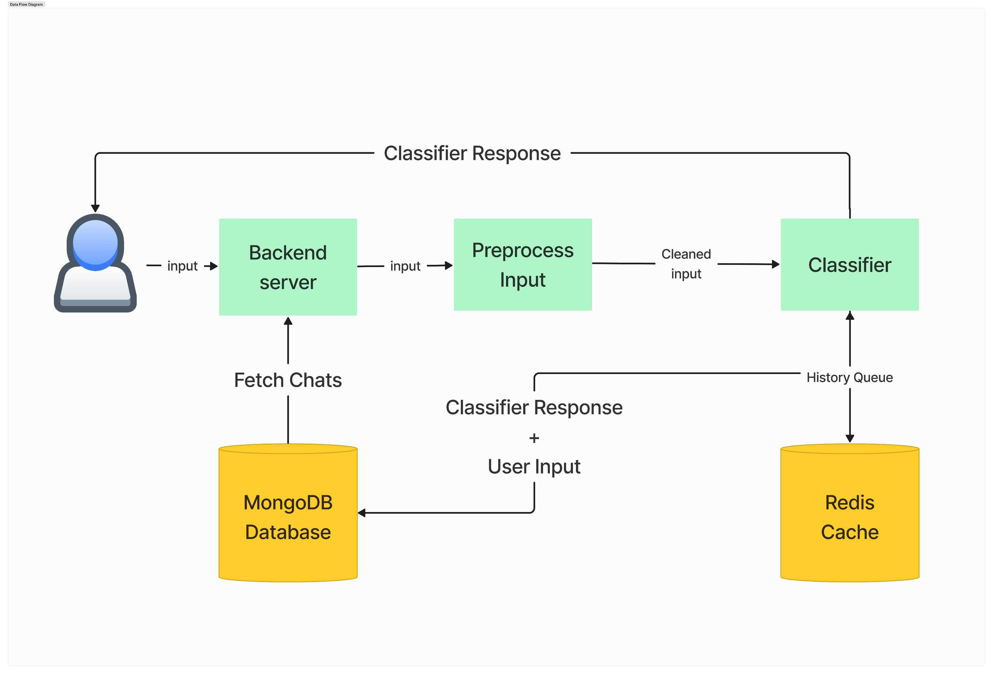
System Data Flow

Slide 22
Data Handling & Session Management
Effective data handling ensured seamless flow of data and session handling tied each user with their information in the system.
Data Handling
All user’s data including their bots, preferences, history and meta context were stored in Mongo DB NoSQL database.
User’s input messages were preprocessed before processing by the models.
Session Management
User’s session is initiated when the user logs into the system and their identifier token is stored as a cookie.
The token is used to identify the user with every request.

Slide 23
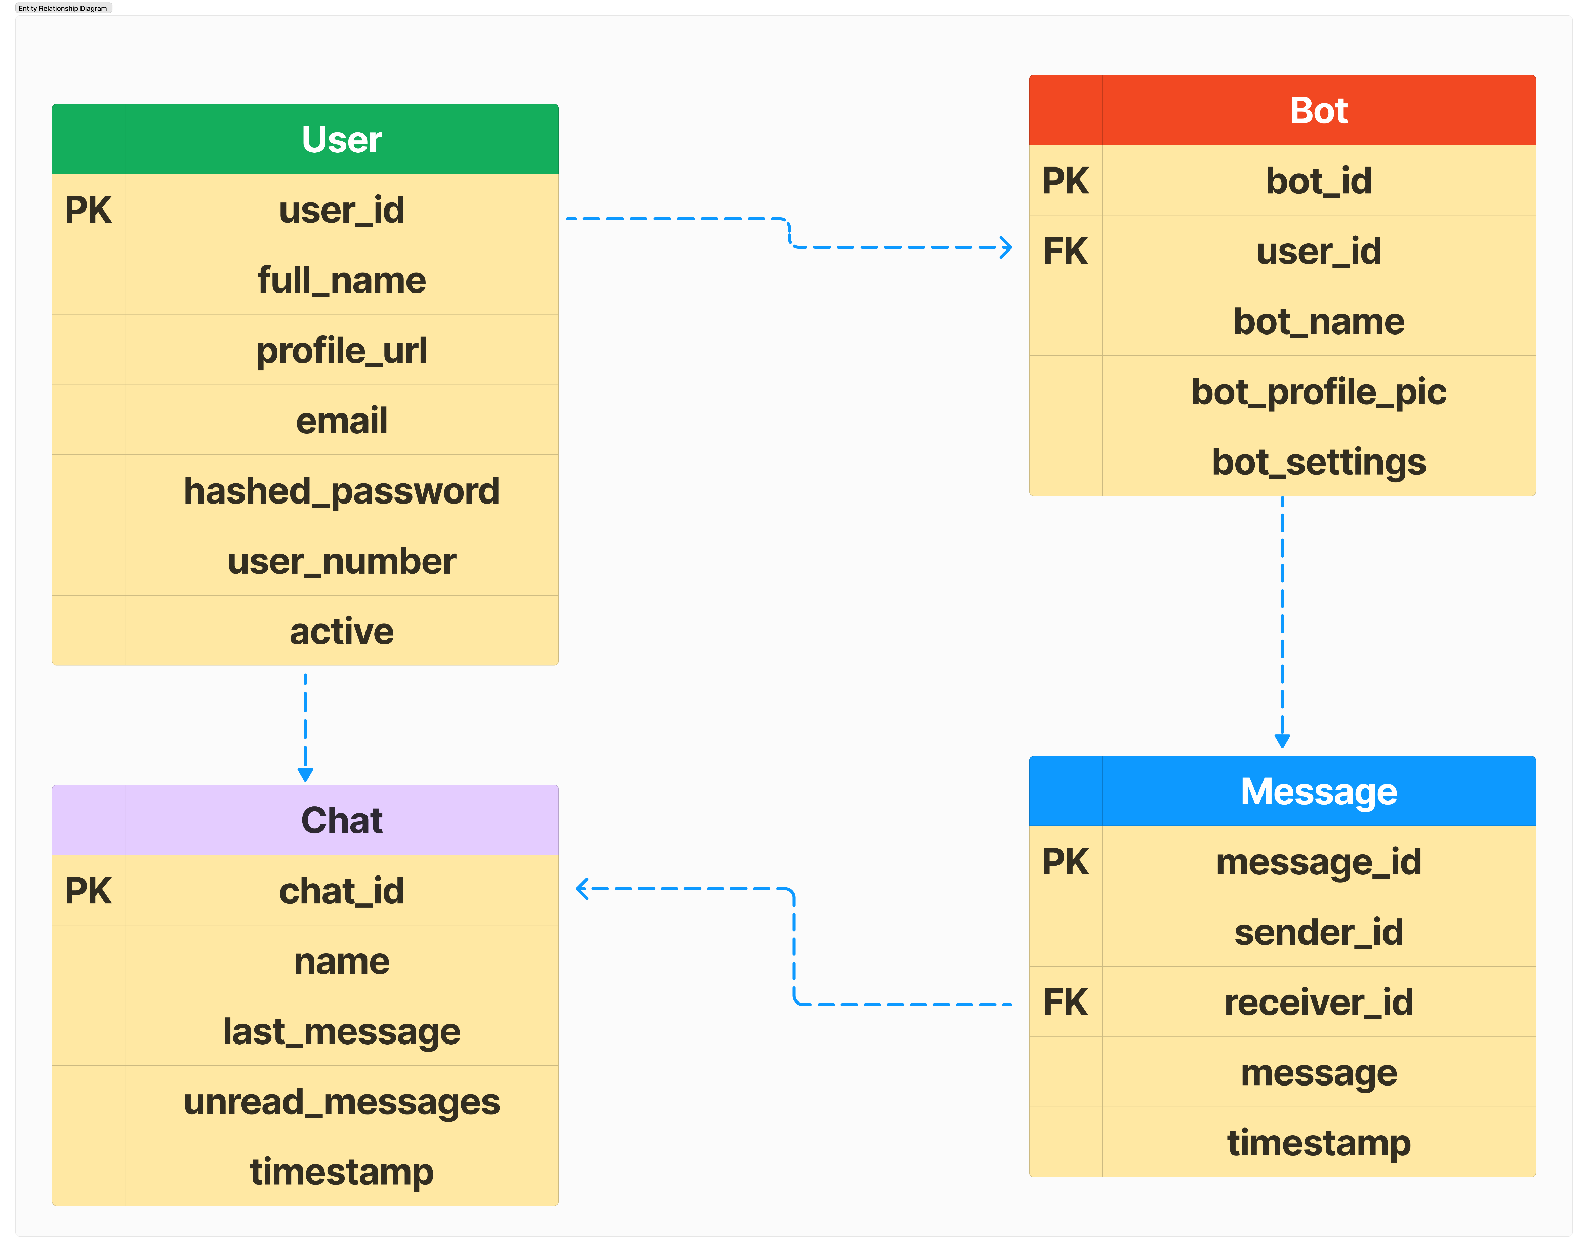
Entity Relationship Diagram

Slide 24
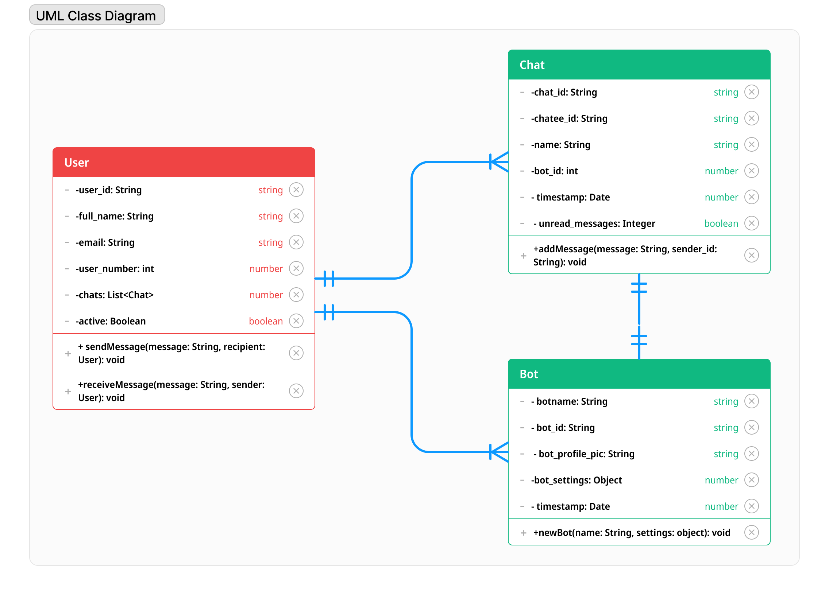
UML Class Diagram

Slide 25
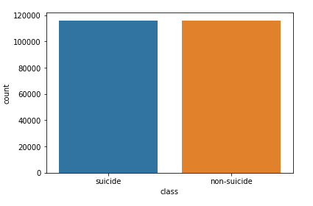
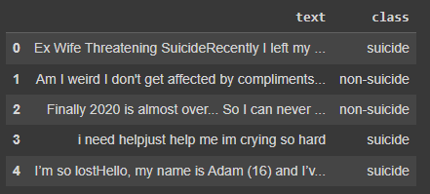
Data Collection and Wrangling
I used data from a Kaggle dataset which consisted of post from the social media platform reddit. The dataset consisted of 2 columns where “text” indicated the post content and “class” indicated the label of the posts. A total of 232,074 posts were scraped from 2 subreddits, namely SuicideWatch and teenagers to build this dataset. Posts from SuicideWatch was labelled as suicidal, while the posts collected from teenagers was labelled as non-suicidal, thereby simplifying the collection process.

Slide 26
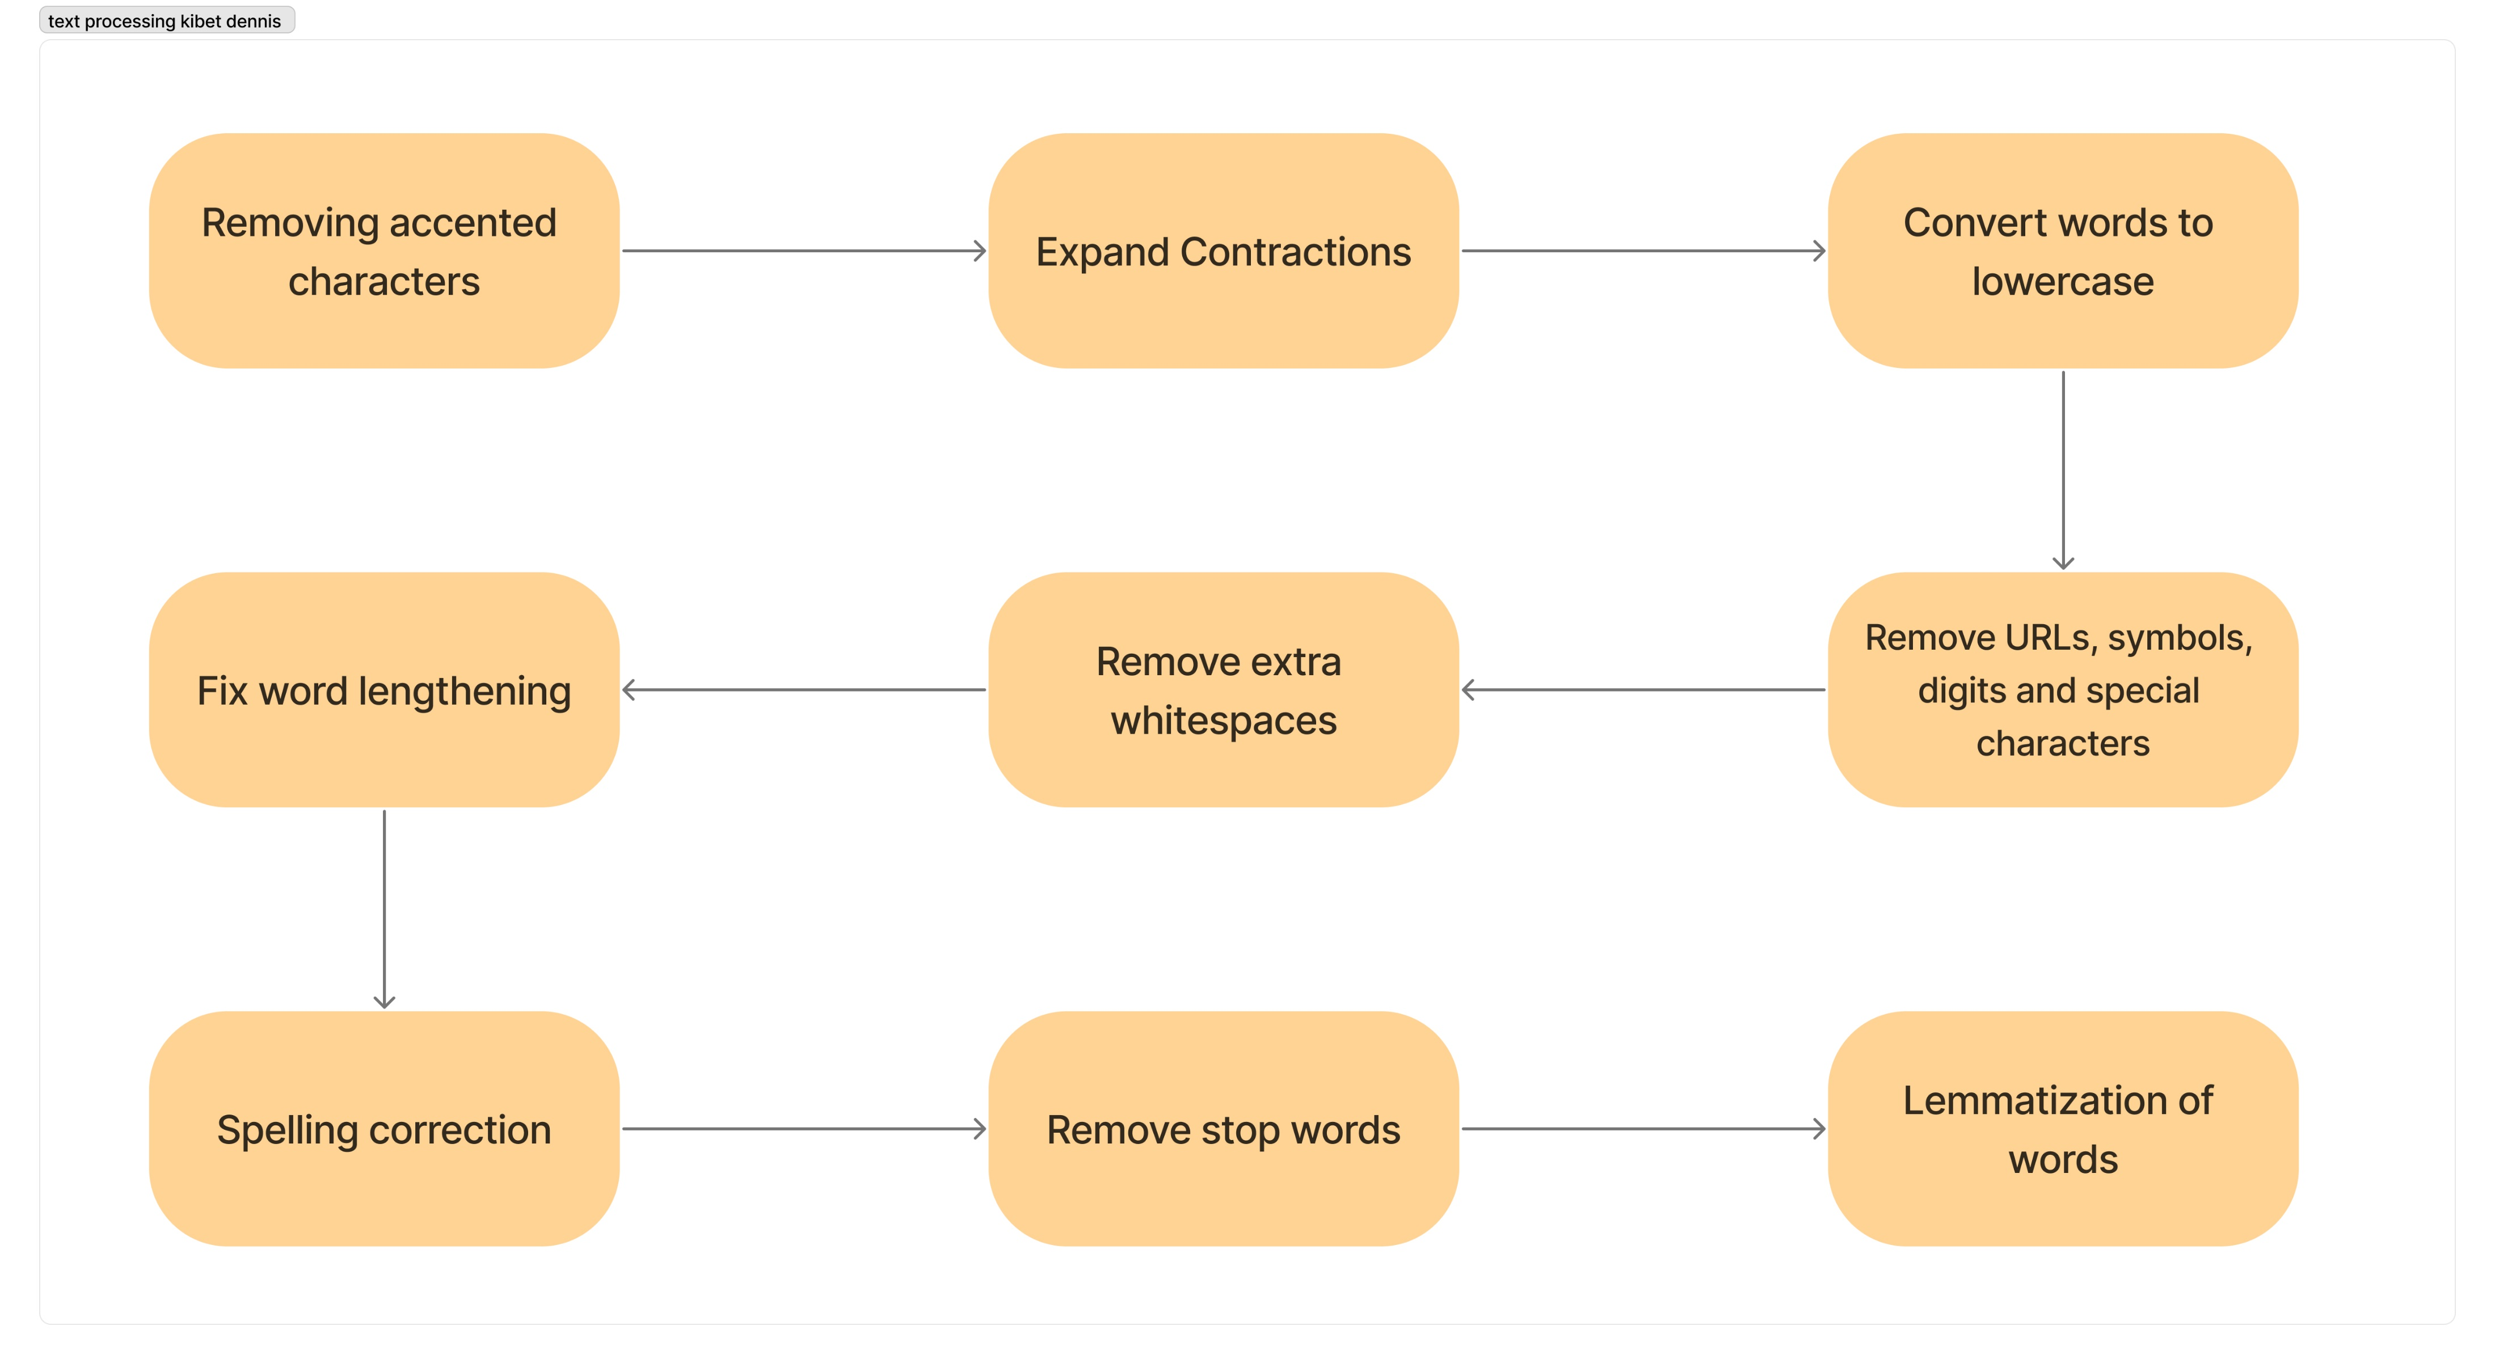
Text Preprocessing and Data Cleaning
Preprocessing aims to obtain clean data to improve the detection process's accuracy. The figure shows the steps for cleaning the dataset.
Data cleaning – this involved removing irrelevant words and removing empty rows from the dataset

Slide 27
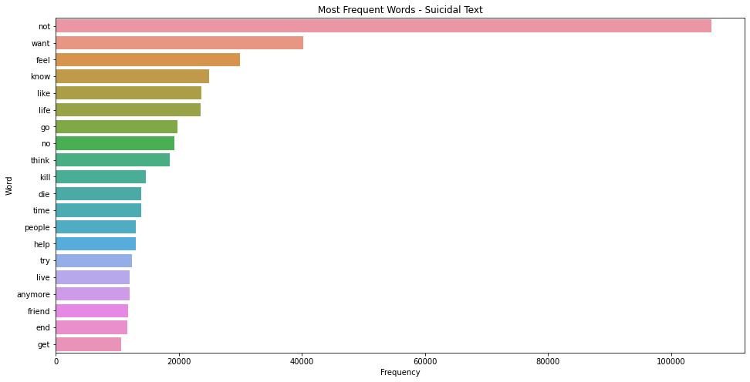
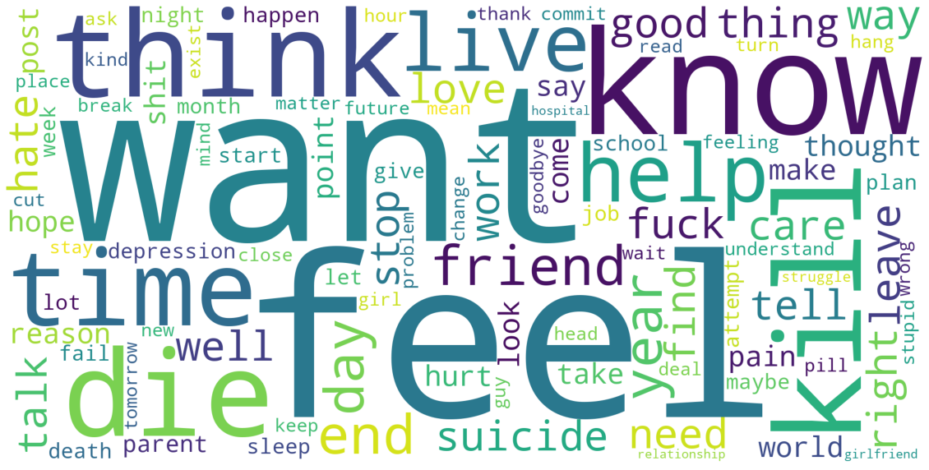
Data Exploration
From the cleaned dataset, the text corpus labelled as suicidal was filled with negative words like “kill”, “die”, “hate”, “death”, “end”, and “help”.
This observation suggested that suicidal texts tend to express more negative sentiments.

Slide 28
Future Improvements
Model Trimming – For faster response times and for the models to have smaller compute requirements, the models should be reduced in size while keeping the performance.
Larger datasets – Future models should be trained on larger datasets for higher accuracy, recall, and precision metrics of the model.
Large Language Model (LLM) – The chatbot can also be implemented using LLMs which can perform even better on conversational topics, since they are trained in bigger more general knowledge.
Language – The model can also be trained on multiple other languages to reach to a wider international community.

Slide 29
Time Schedule
This Project is planned to take up-to Eighteen weeks.
Project Activities | Duration in Weeks
Planning and Analysis | 3
Designing | 4
Development | 9
Testing | 2
TOTAL | 18

Slide 30
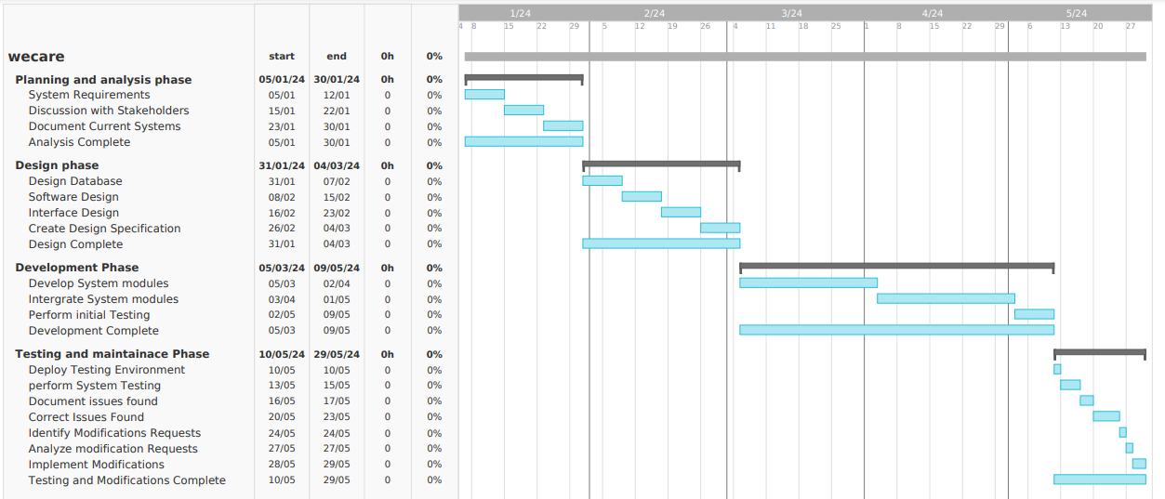
Gantt chart

Slide 31
Project Budget
Expenses | Cost in Shillings
Laptop | 50,000
Internet Subscription | 5,000
Travel Expenses | 10,000
Food | 3,000
Domain name | 2,000
Hosting | 15,000

Slide 32
Thank You

